Slide 1
Food demand forecasting analysis
File created on: 11/13/2022 2:05:14 PM

Slide 2
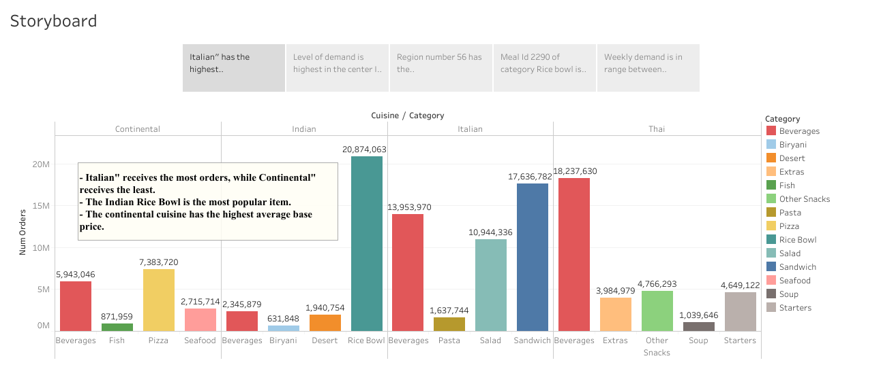

Slide 3
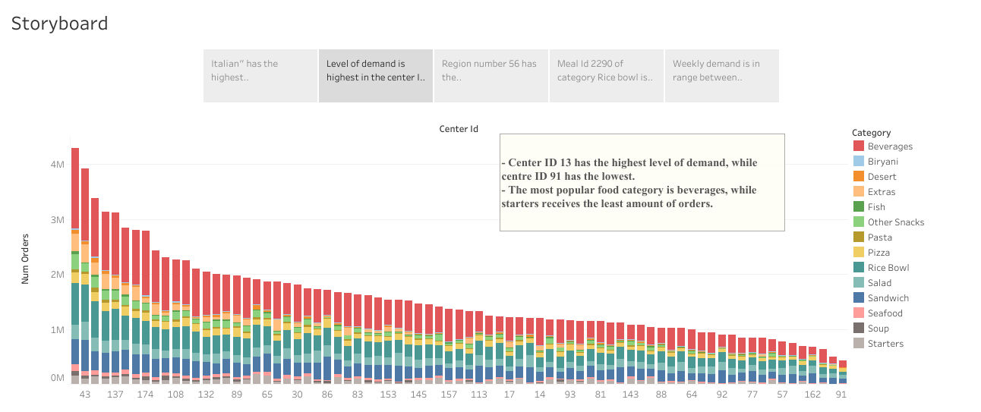

Slide 4
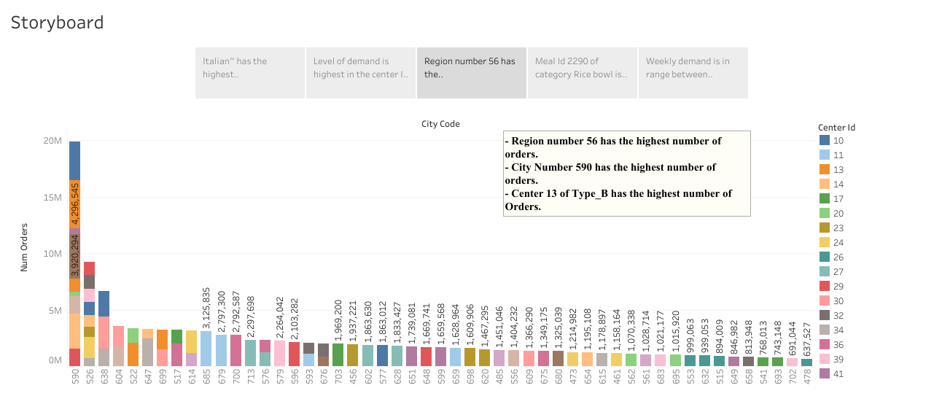

Slide 5
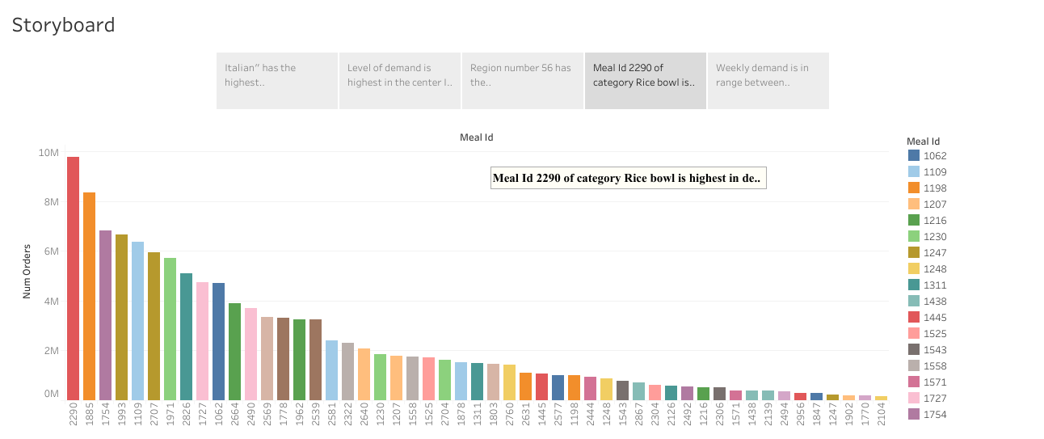

Slide 6
